Slide 1


Your ESLint — your (custom) rules
TallinnJS, 13 September 2022
Bogdan Bashev - Staff Quality Engineer

Slide 2

HOW DOES VERIFF WORKS
IDENTITY VERIFICATION

Slide 3
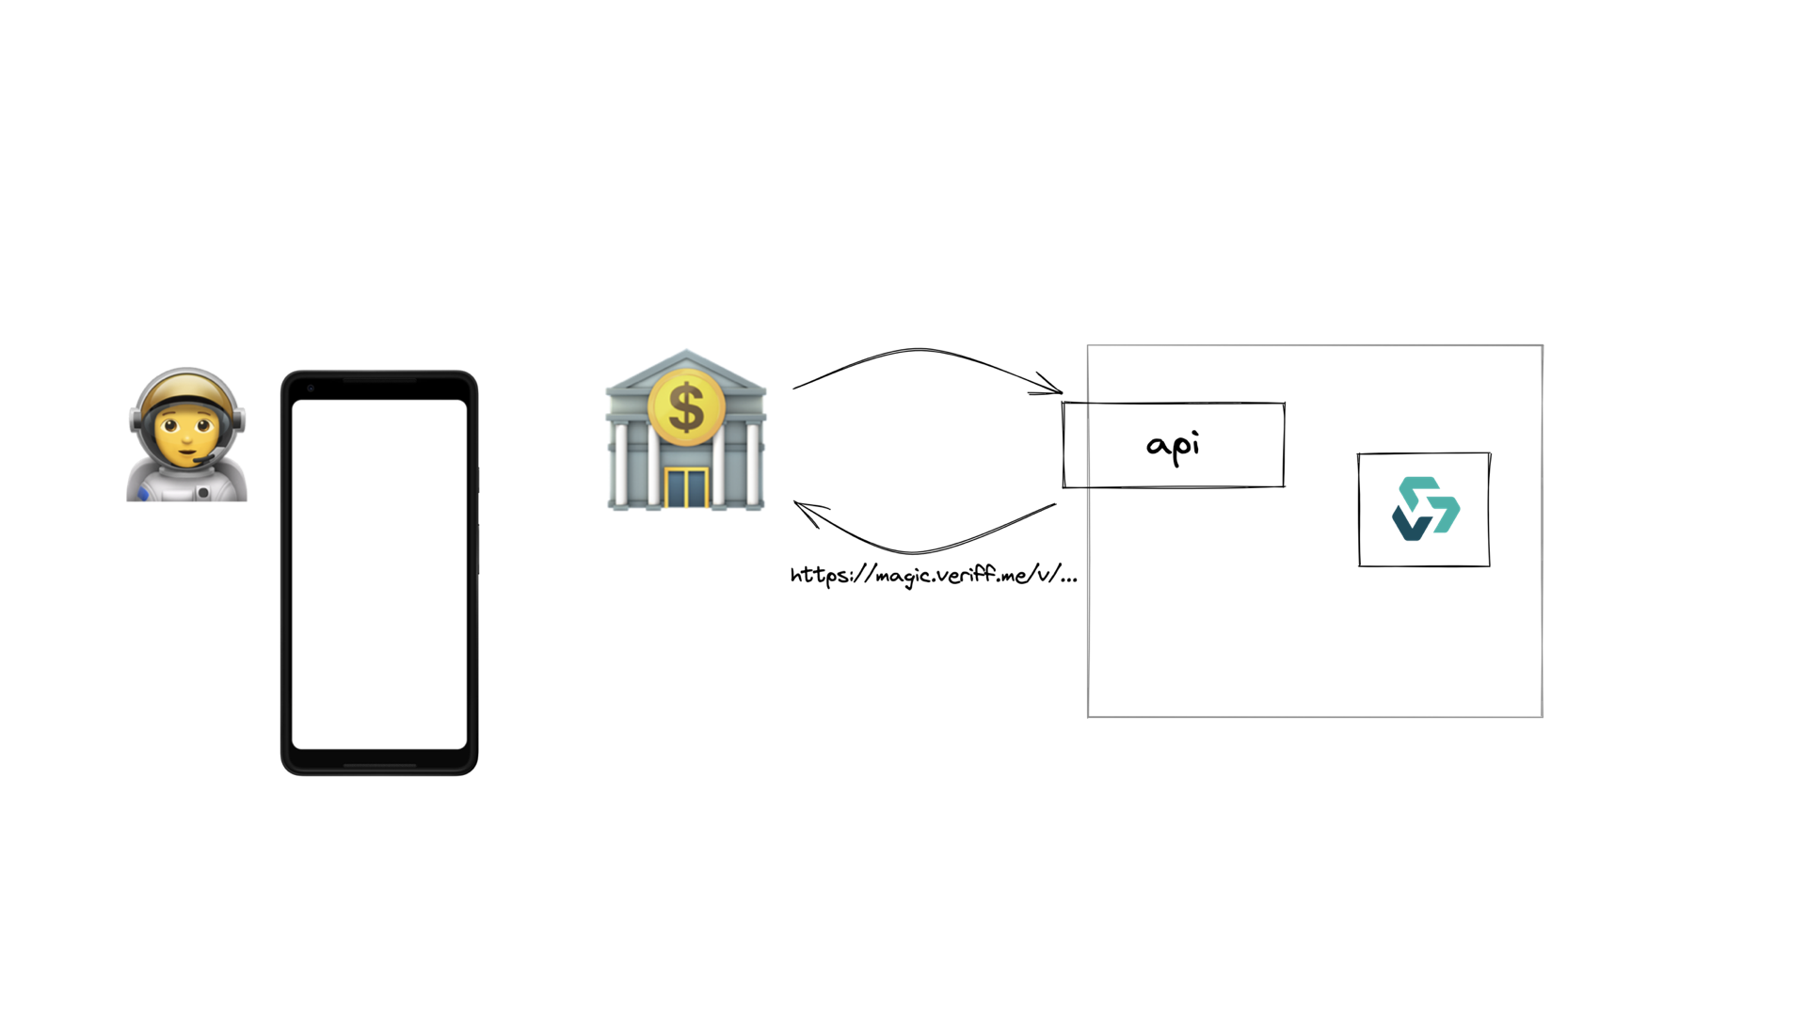

Slide 4


Slide 5
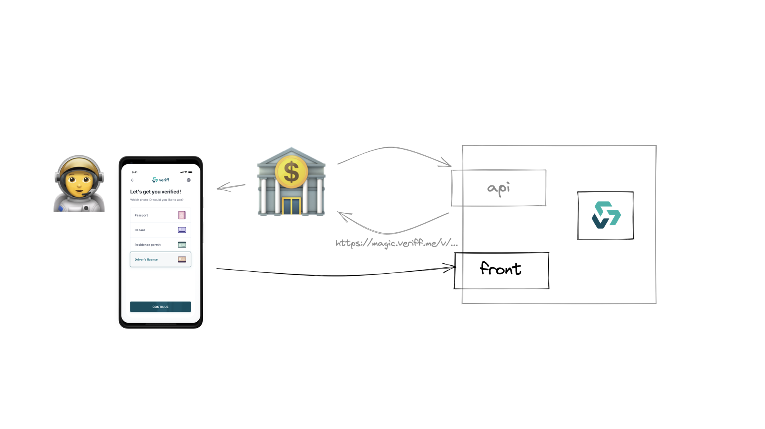

Slide 6
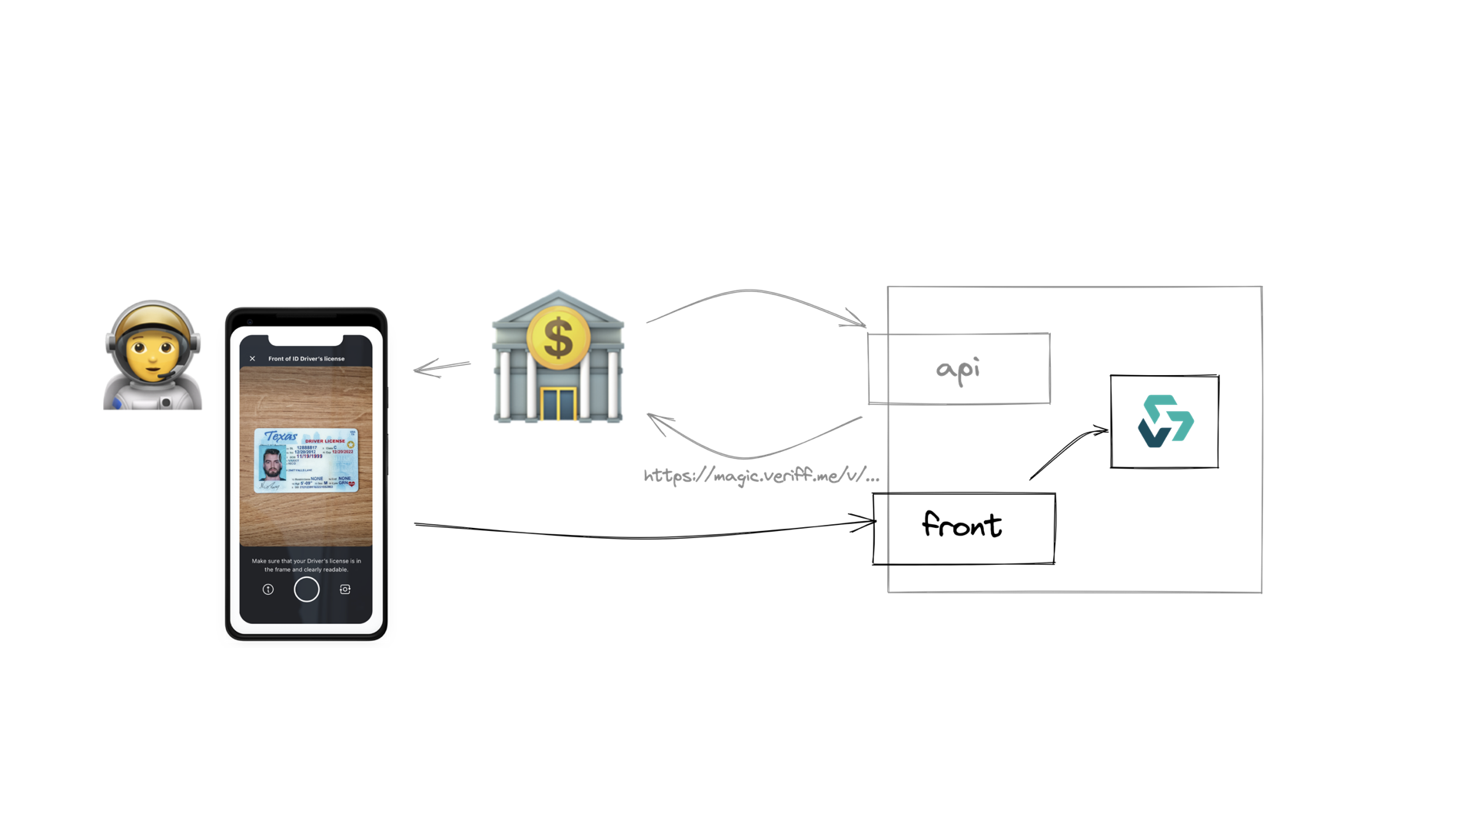

Slide 7
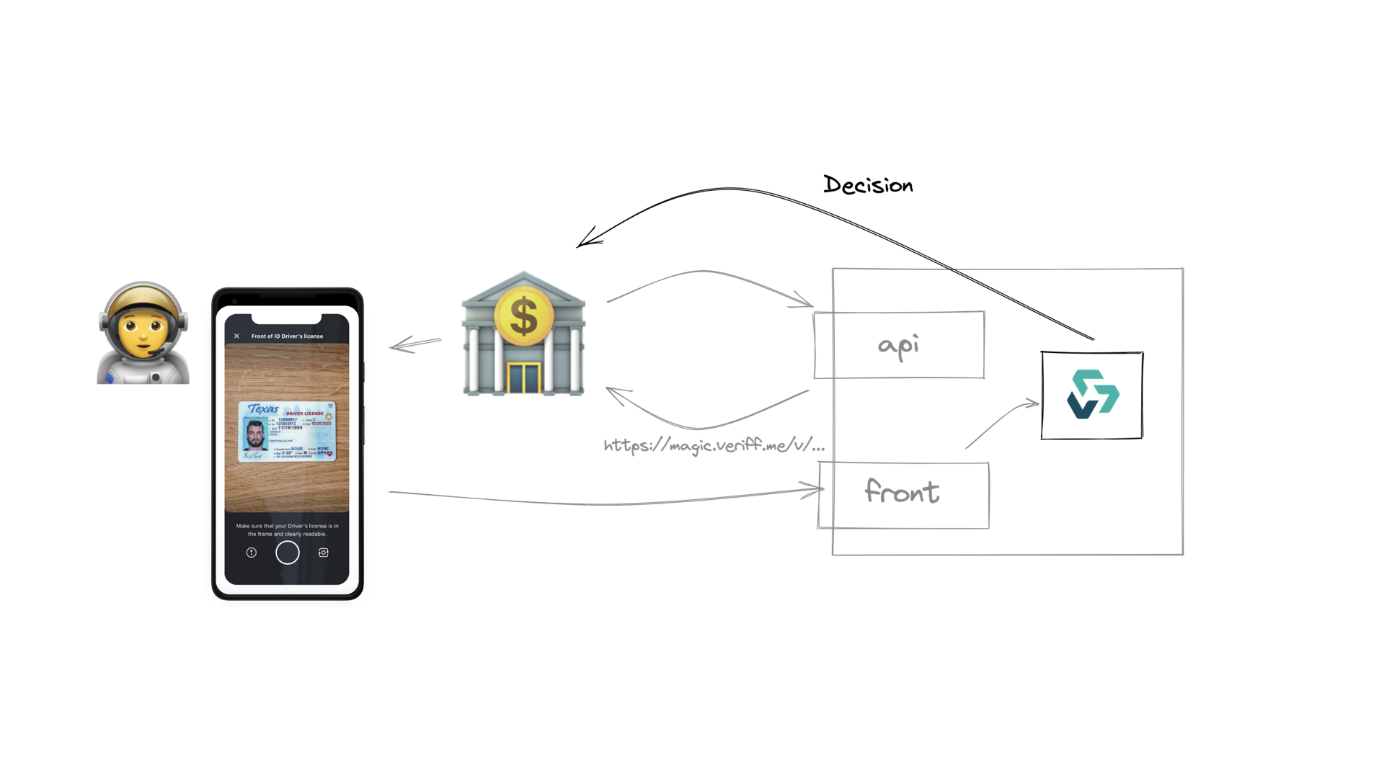

Slide 8
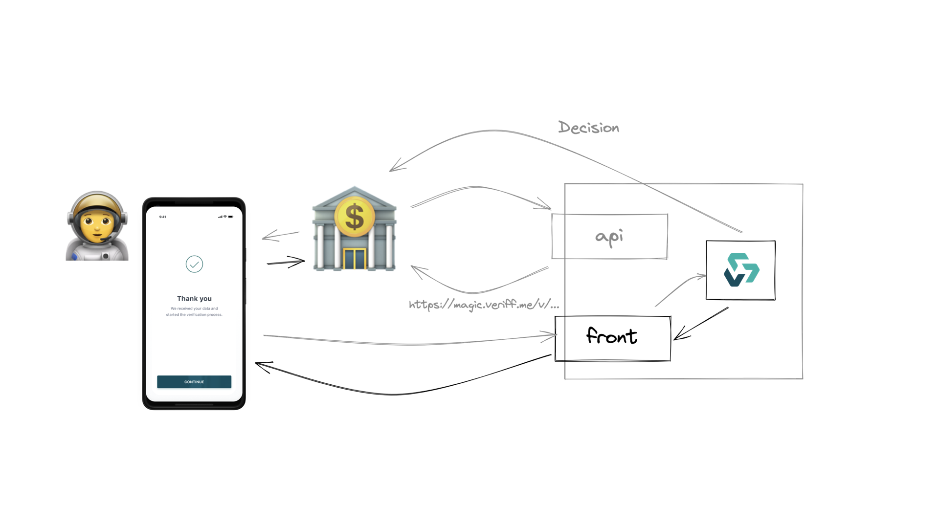

Slide 9
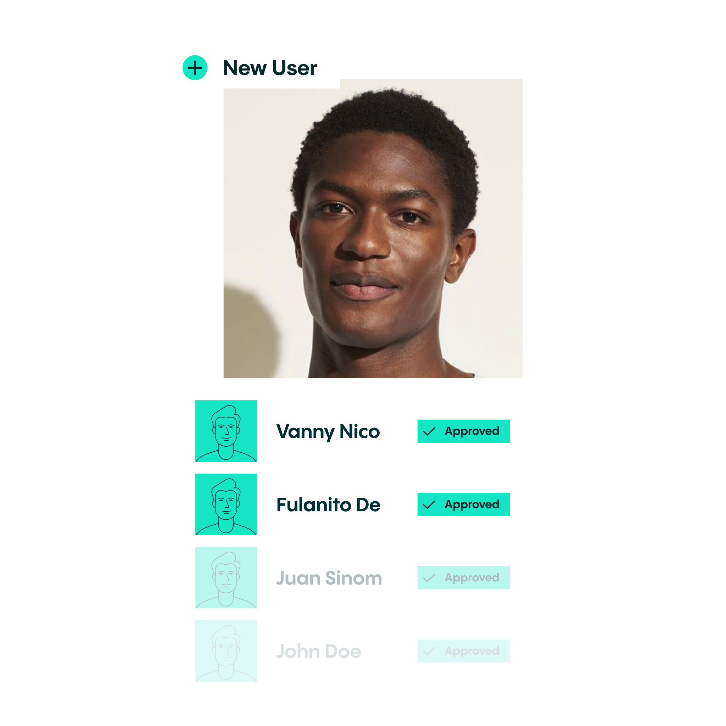

About me
Despite popular belief
does not own a staff
Cypress?
Did you mean Cypress Hill?
Know how to turn Playwrong into Playwright
Staff Quality Engineer
Bogdan
Bashev

Slide 10

Spotlight
Why would you want to use custom ESLint rules?
How to generate your own custom rule using Yeoman
3. How to parse syntax tree with AST Explorer and ESQuery
4. How to test and enable your new rule

Slide 11


Fixers
TypeScript support
maybe we should have TallinnTS?
CI/CD
but plugin published to NPM
.
Todd Howard

Slide 12
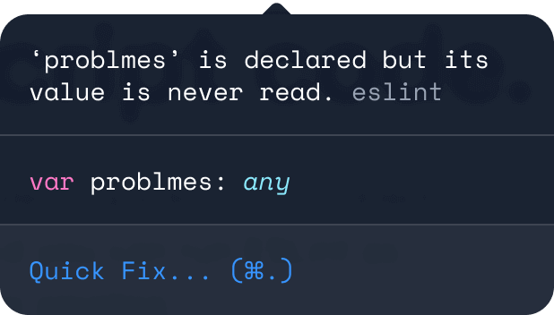
With ESLint you can impose the coding standard or detect common problmes using a certain set of standalone rules.
Notes:
Someone from the audience had experience with writing their own plugins and custom rules for ESLint?

Slide 13
Someone from the audience had experience with writing their own plugins and custom rules for ESLint?

Slide 14


SAVE TIME
IN CODE REVIEW
TAILOR CODE ANALYSIS FOR YOUR TEAM

Slide 15
You want to enforce a specific rule
You want to enforce a specific rule in your codebase, and this rule is not going to be relevant outside of your company (in other codebases).

Slide 16
Your engineering team has a strong preferences
For example, a rule enforcing the use of React Flow types over the more experimental React$ types

Slide 17
You just cannot find open-source plugin
For example, there is Cypress, Allure and Playwright ESLint plugins, but there are no plugins for Allure annotations for this frameworks.

Slide 18

But what about existing solutions?
Open-Source ESLint plugins
and configs
IDE plugins
Templates!

Slide 19
TL;DR;
You’re creating a rule that everyone really, really has to follow
(if they want their code to get checked in)

Slide 20

Team utilising Playwright for UI and snapshot tests
The Problem

Slide 21
Team utilising Playwright for UI and snapshot tests
Tests reporting to Allure TestOps
The Problem

Slide 22
Team utilising Playwright for UI and snapshot tests
Tests reporting to Allure TestOps
To have clear and transparent connection between Jira, automation and case in TMS you need to annotate every test with at least allure.story()
The Problem

Slide 23
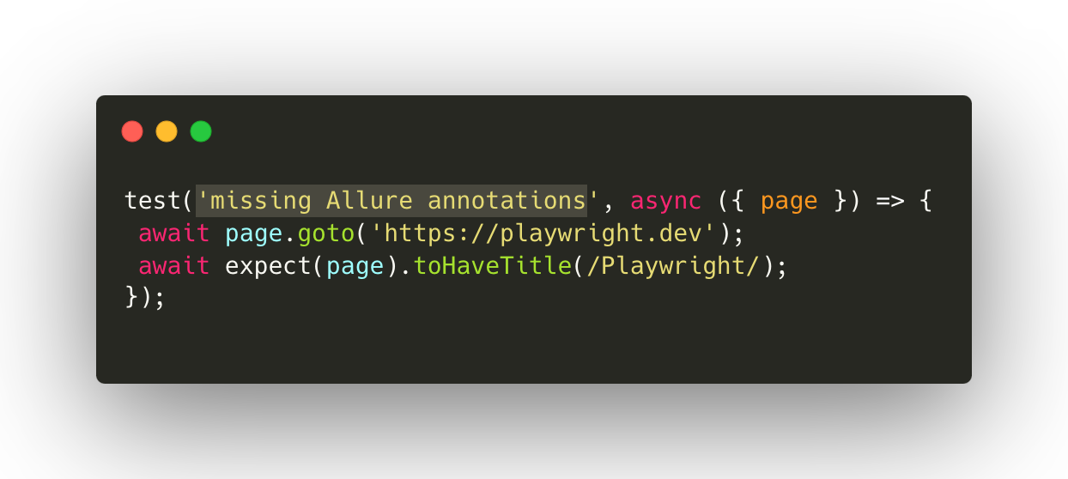

Slide 24
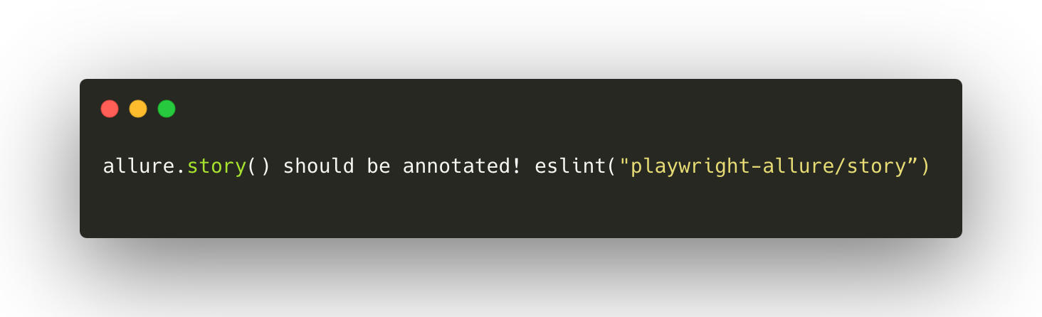

allure.story() should be annotated! eslint("playwright-allure/story”)

Slide 25
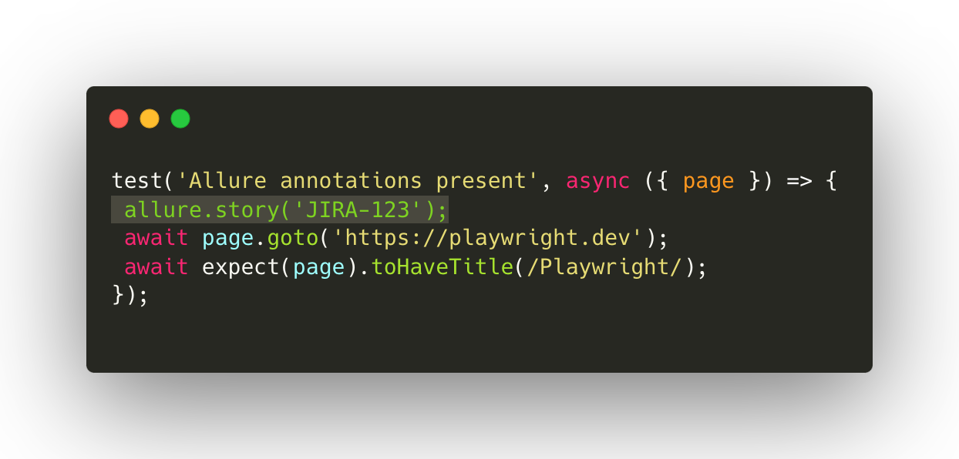

Slide 26
LET’S DO THAT

Slide 27
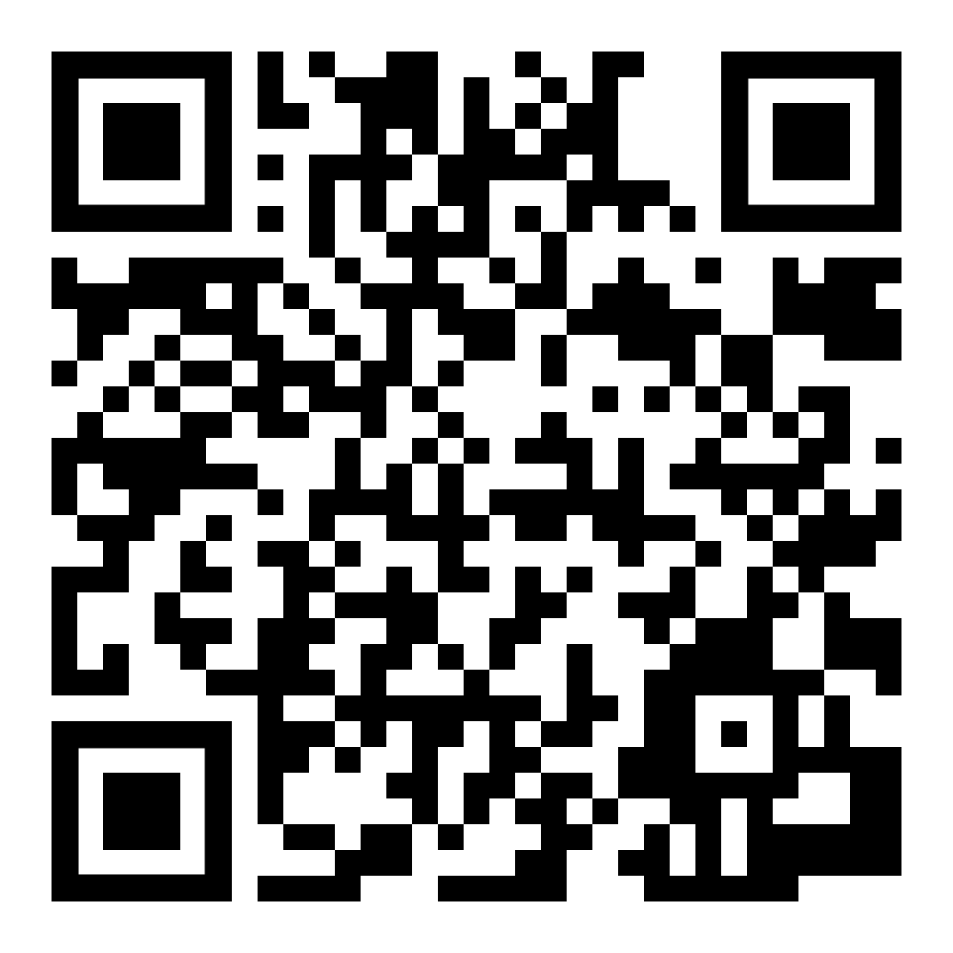
Step-by-step workshop repo and
references can be here:

Slide 28


STEP I
How to generate your own ESLint plugin and rule using Yeoman
Install Yeoman
and Eslint Generator
Init Plugin
Init Rule
You can also init empty project using ESLint
> npm init
> npm init @eslint/config
> tsc --init // for TS

Slide 29
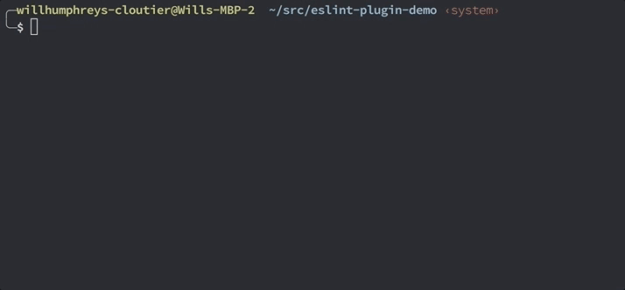
Init Plugin using yo command
You can also init empty project using ESLint
> npm init
> npm init @eslint/config
> tsc --init // for TS

Slide 30
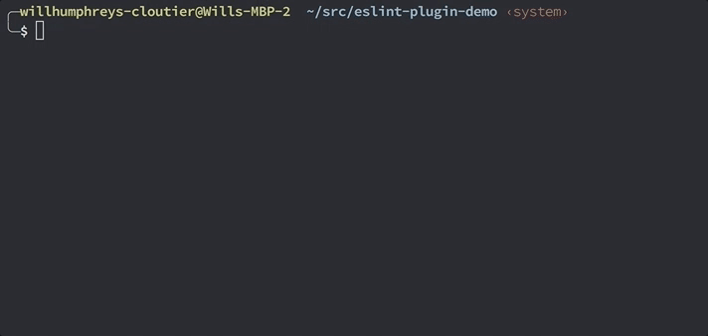
Init Rule using same yo command
You can also init empty project using ESLint
> npm init
> npm init @eslint/config
> tsc --init // for TS

Slide 31
docs/rules/<rule-name>.md This is a Markdown file that documents your rule. You should definitely fill this out before submitting your plugin/rule to help.
lib/rules/<rule-name>.js This is where we’ll write the logic to implement the rule.
tests/lib/rules/<rule-name>.js This is a scaffold of a test suite with an example of a test of some invalid code.

Slide 32
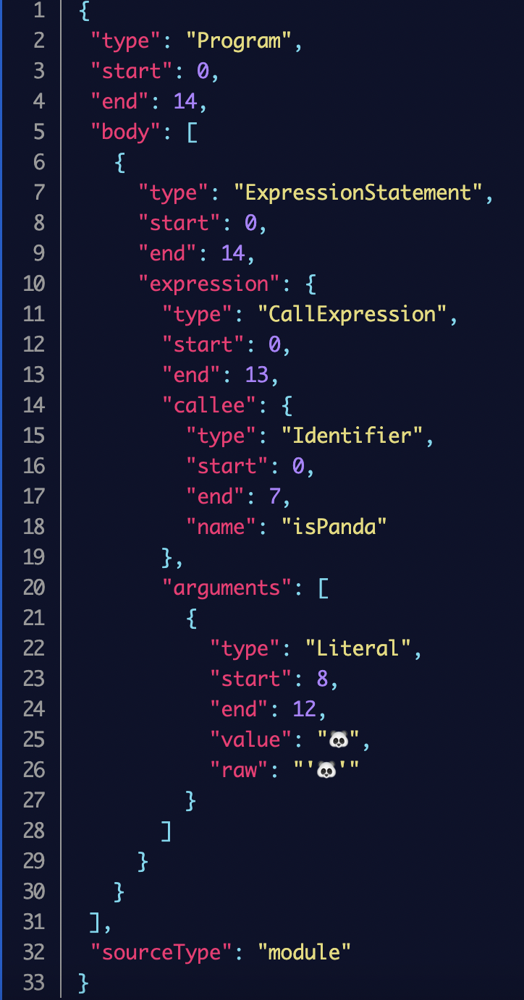
Let’s talk about AST first:
Abstract Syntax Tree or AST
is a tree representations of code
(JSON fine too)

Slide 33
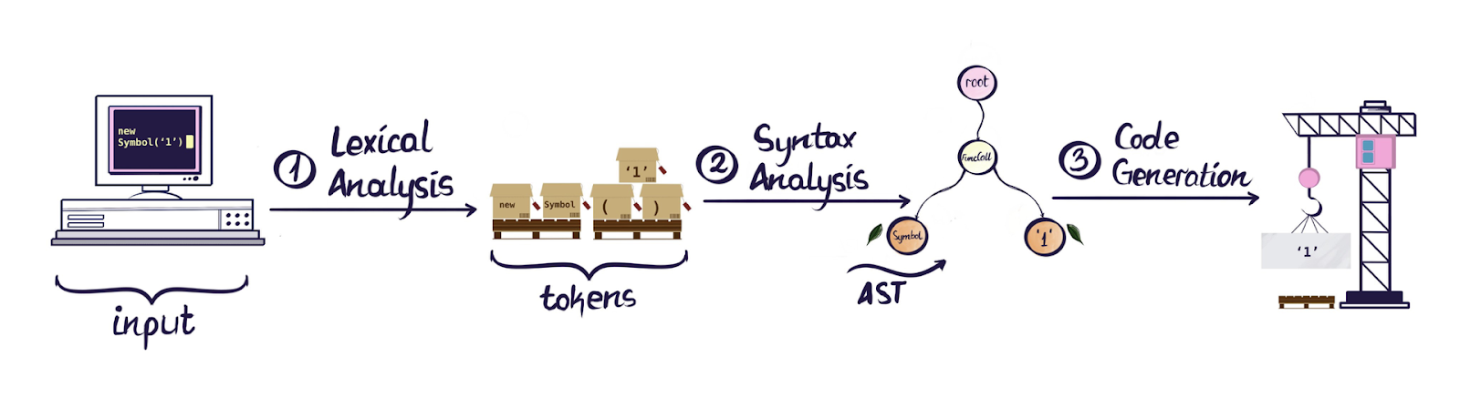
When a compiler transforms some code there are fundamentally the following steps: Code input, Lexical Analysis, Syntax Analysis, Code Generation

Slide 34
When a compiler transforms some code there are fundamentally the following steps: Code input, Lexical Analysis, Syntax Analysis, Code Generation

Slide 35
When a compiler transforms some code there are fundamentally the following steps: Code input, Lexical Analysis, Syntax Analysis, Code Generation

Slide 36
When a compiler transforms some code there are fundamentally the following steps: Code input, Lexical Analysis, Syntax Analysis, Code Generation

Slide 37
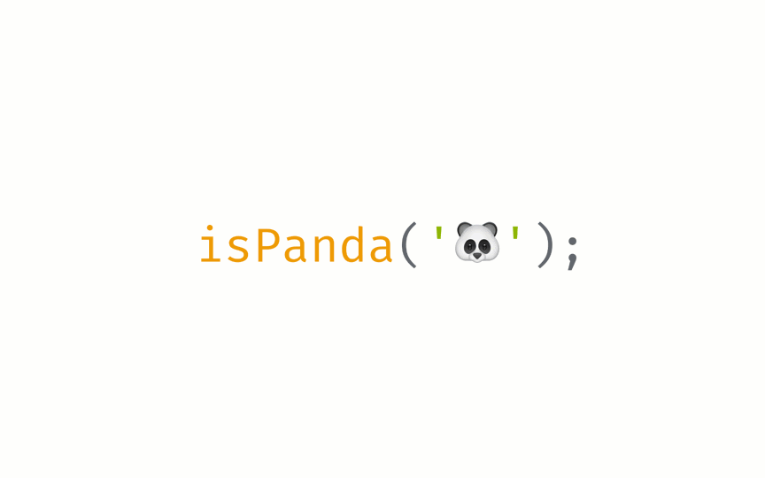


Lexical Analysis: code that you wrote is going to be converted into a set of tokens describing the different parts of your code.

Slide 38
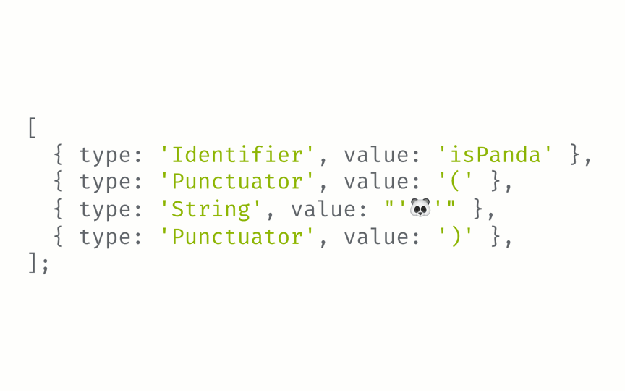
Syntax Analysis: converts our tokens into a tree that represents the actual structure of the code.

Slide 39
STEP II
How to parse syntax tree with AST Explorer and ESQuery
Paste you snippet into astexplorer.net
AST Explorer settings used:
> Parser: @babel/eslint-parser-7.13.14
> Transformer: ESLint v8-8.9.0

Slide 40
STEP II
How to parse syntax tree with AST Explorer and ESQuery
Paste you snippet into astexplorer.net
Explore your AST!

Slide 41
STEP II
How to parse syntax tree with AST Explorer and ESQuery
Paste you snippet into astexplorer.net
Explore your AST!
Configure Parser and Transformer (TS supported too!)

Slide 42
STEP II
How to parse syntax tree with AST Explorer and ESQuery
Paste you snippet into astexplorer.net
Explore your AST!
Configure Parser and Transformer (TS supported too!)
Find your Entry Point using AST Explorer + esquery for debug

Slide 43
STEP II
How to parse syntax tree with AST Explorer and ESQuery
Paste you snippet into astexplorer.net
Explore your AST!
Configure Parser and Transformer (TS supported too!)
Find your Entry Point using AST Explorer + esquery for debug
Write your rule which will report on negative cases and won't be triggered on positive ones

Slide 44
STEP II
How to parse syntax tree with AST Explorer and ESQuery
Paste you snippet into astexplorer.net
Explore your AST!
Configure Parser and Transformer (TS supported too!)
Find your Entry Point using AST Explorer + esquery for debug
Write your rule which will report on negative cases and won't be triggered on positive ones
Add more tests and re-run (TDD)

Slide 45
SWITCH TO AST EXPLORER HERE

Slide 46
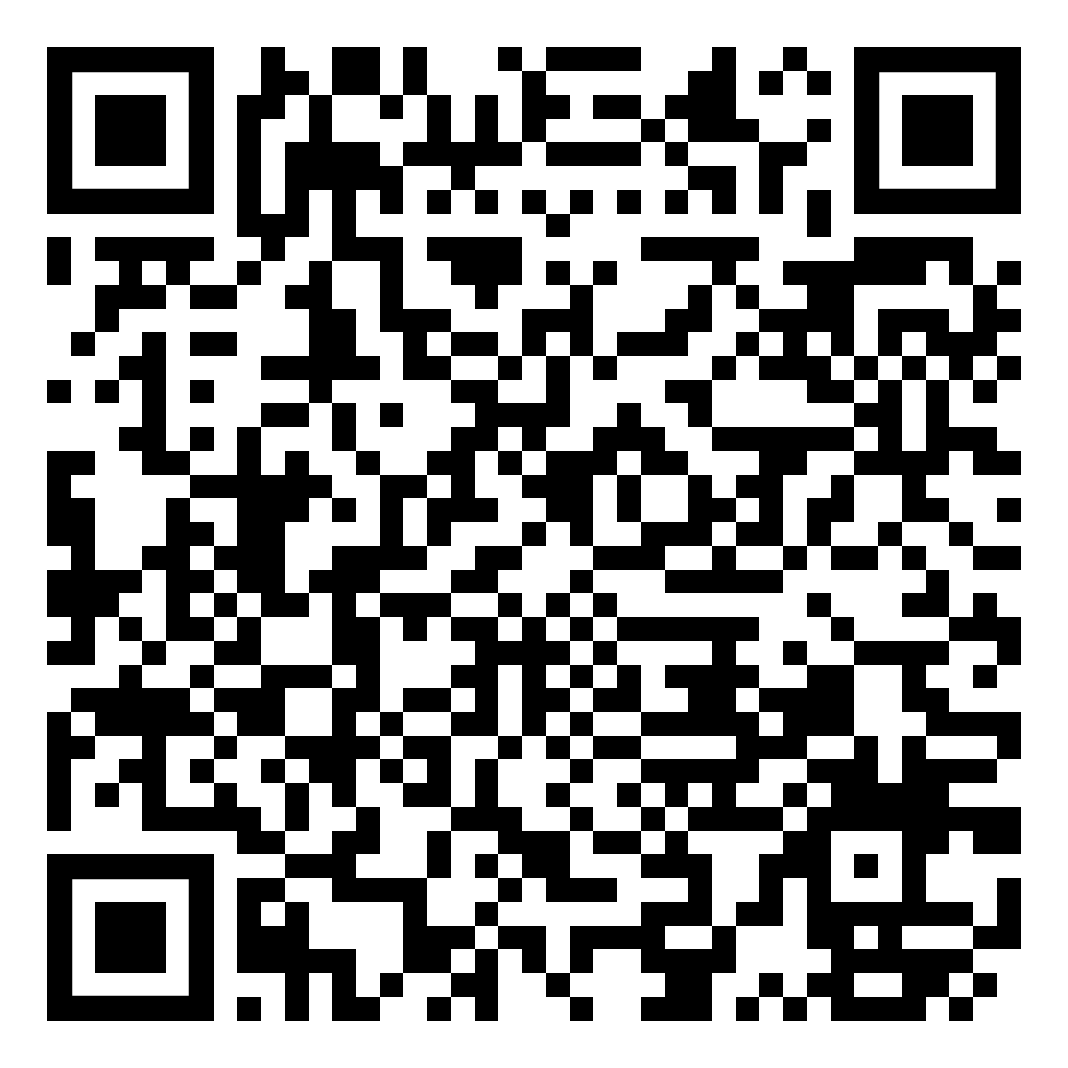
AST Explorer snippet for this talk can be found here:

Slide 47
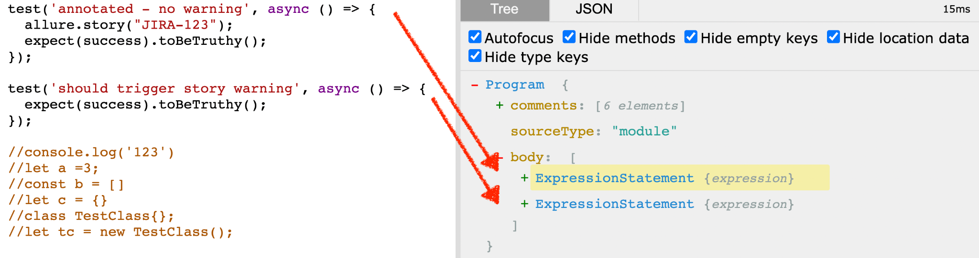
Every test is actually an ExpressionStatement

Slide 48
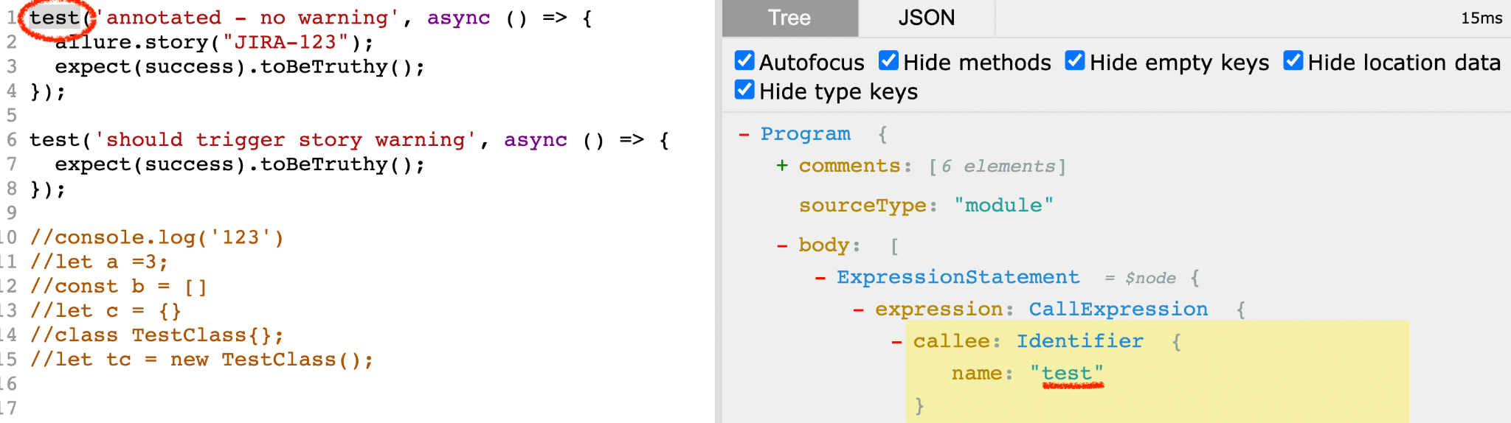
Our test call is CallExpressions with Identifier ‘test’
So full path to our test will be something like
Program > body > ExpressionsStatement > expression > CallExpression

Slide 49
But we don’t need to parse from the Program Root!

Slide 50
We can use ESQuery library for querying the AST output for patterns of syntax using a CSS style selector system. It’s very helpful for narrowing down or debugging the search for target node.

Slide 51
ESQuery selectors are like JQuery* ones but for AST
*XPath also looks quite the same

Slide 52
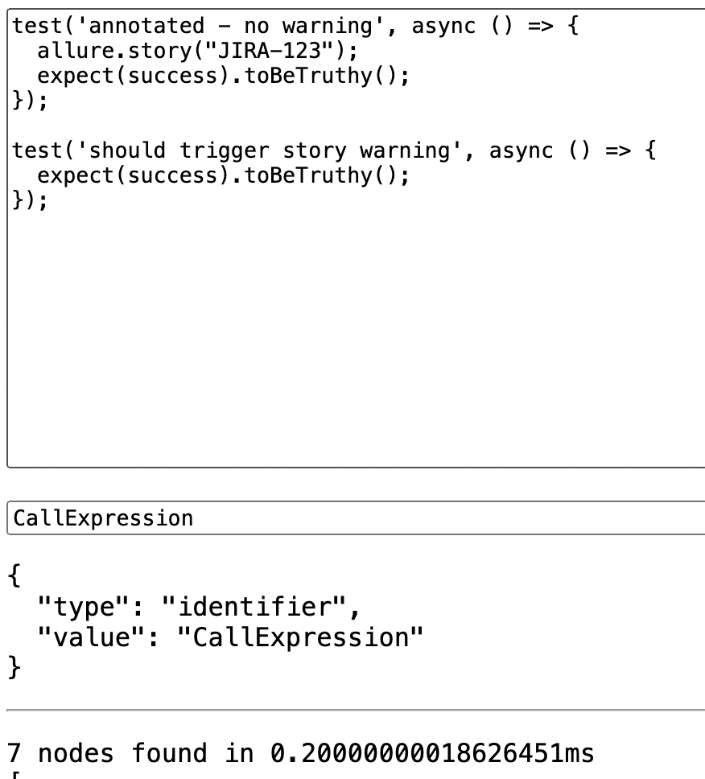
Let’s query all CallExpressions
7 results > 2 tests
We need to narrow search down

Slide 53
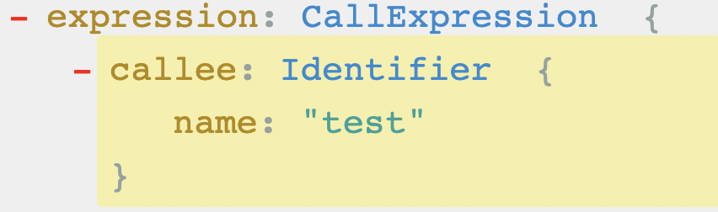
We know for sure,
what our CallExpression is very specific from AST Explorer

Slide 54

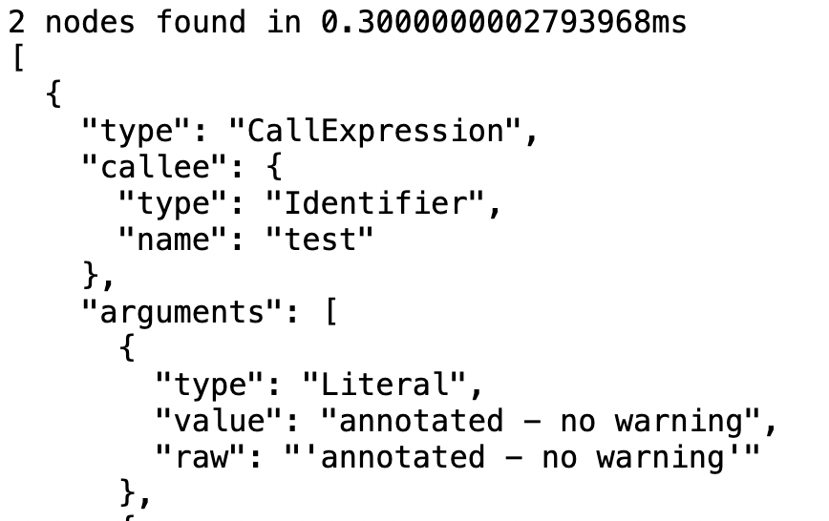
Let’s query all CallExpressions having Callee with name ‘test’

Slide 55
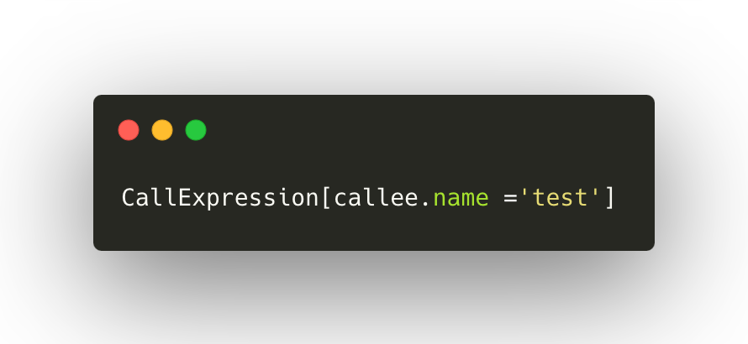

Slide 56
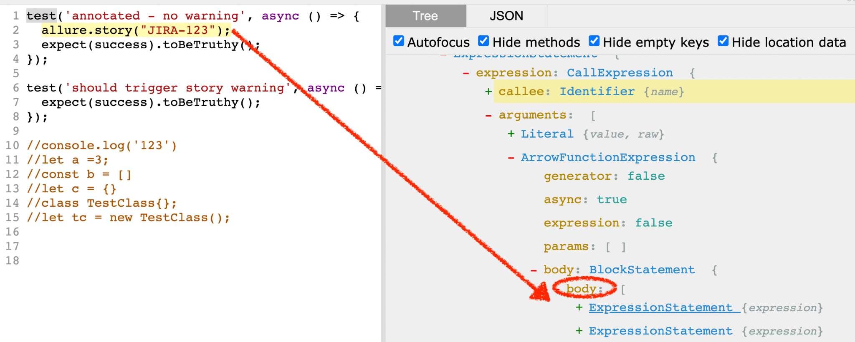
To be able to find annotations in test we need to reach for test body first:
With AST Explorer it's not that hard to find out what test body lies under
TestNode > arguments[1] > body > body

Slide 57
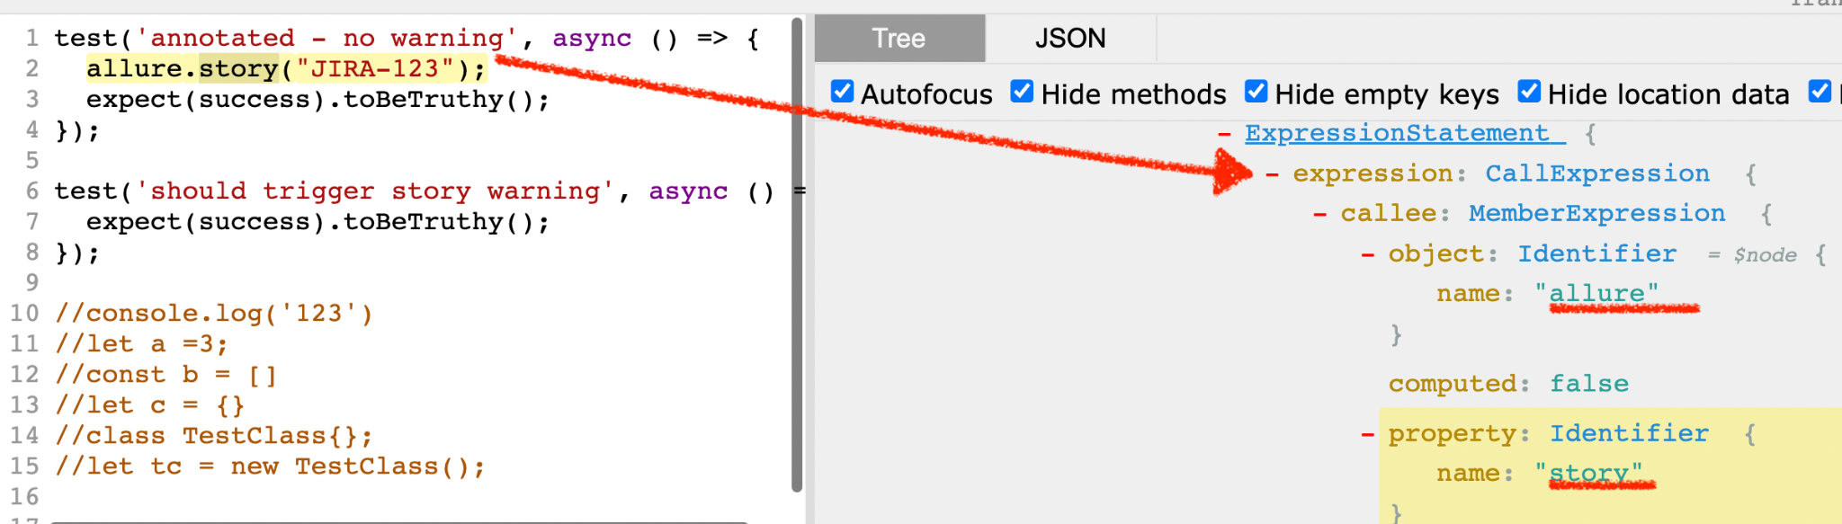
But what about our Allure story annotation in test?
It’s also a CallExpression with callee. But this callee contains object ‘alllure’ and property ‘story’.

Slide 58
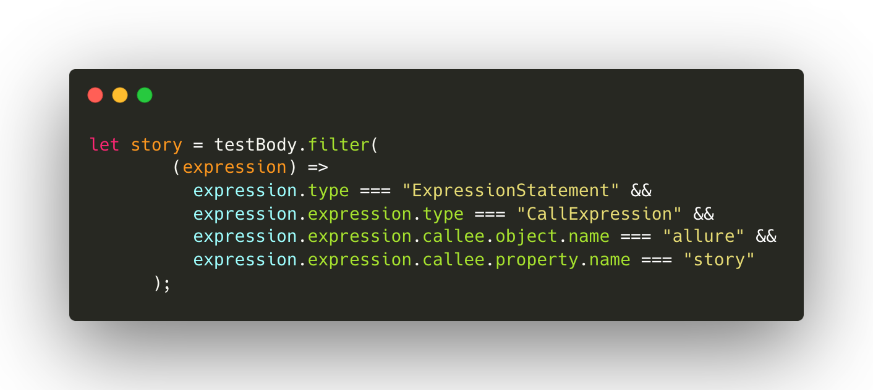
All we need is to filter testBody to find Allure story annotations.
If resulting array is empty - we need to throw ESlint warning.

Slide 59
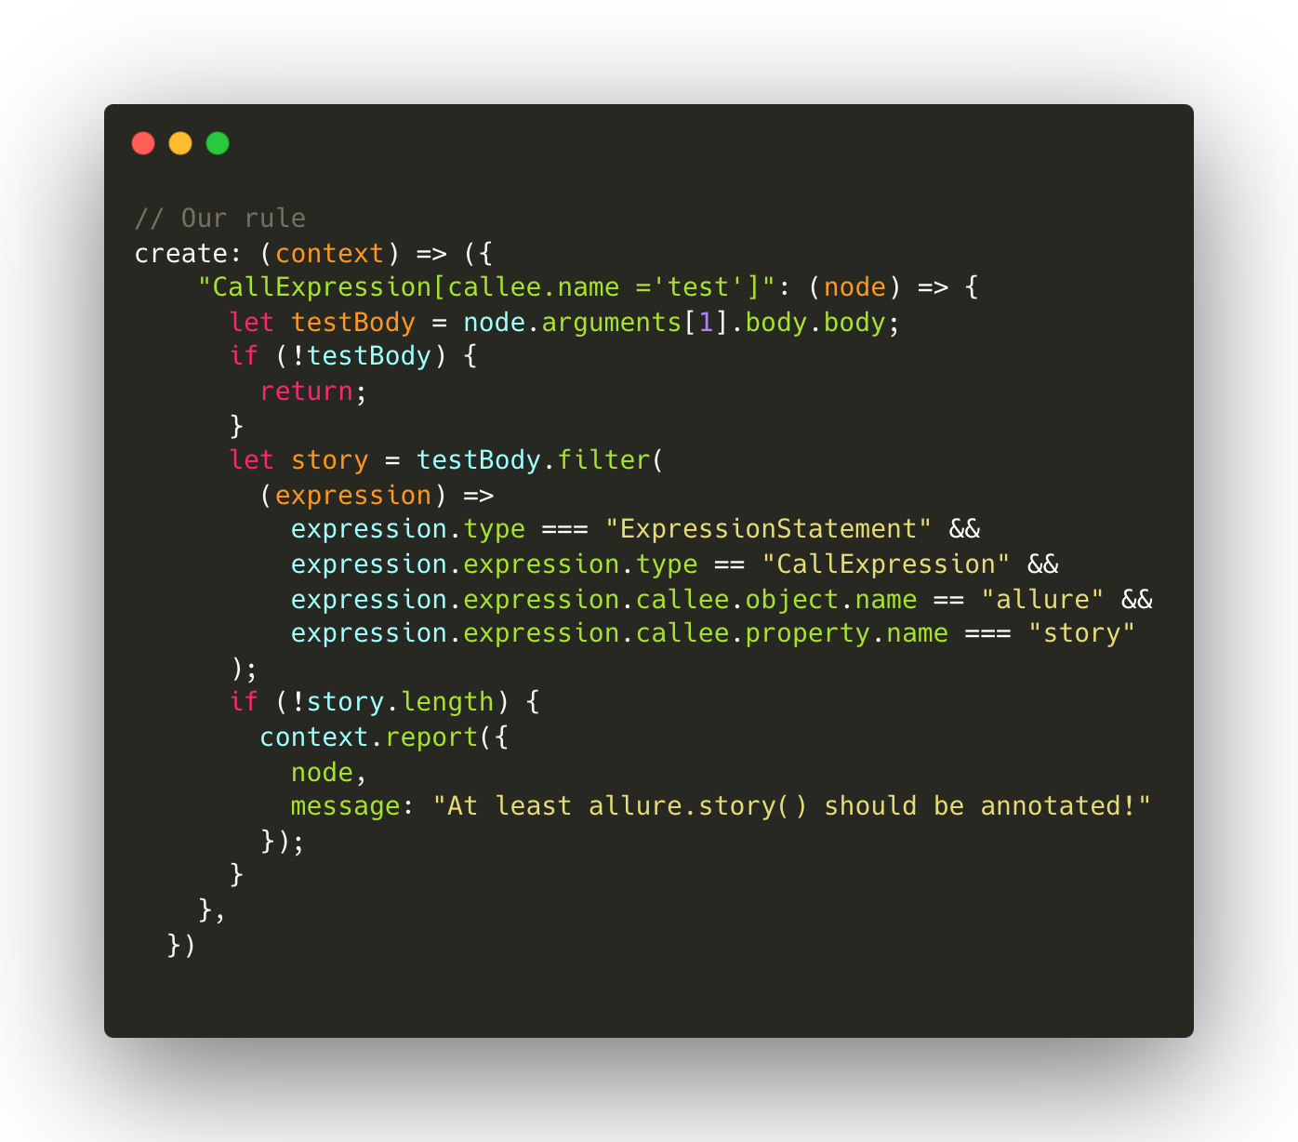

Slide 60


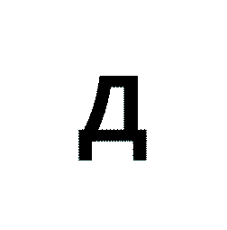


STEP III
How to test and enable your new rule
Use pre-provisioned Mocha tests with npm test. You can also midnight-smoker to test before publish.

Slide 61
STEP III
How to test and enable your new rule
Use pre-provisioned Mocha tests with npm test. You can also midnight-smoker to test before publish.
Store it in your repository and add "eslint-plugin-<plugin_name>": "file:/path/to/plugin" to your package.json

Slide 62
STEP III
How to test and enable your new rule
Use pre-provisioned Mocha tests with npm test. You can also midnight-smoker to test before publish.
Store it in your repository and add "eslint-plugin-<plugin_name>": "file:/path/to/plugin" to your package.json
Use npm link

Slide 63
STEP III
How to test and enable your new rule
Use pre-provisioned Mocha tests with npm test. You can also midnight-smoker to test before publish.
Store it in your repository and add "eslint-plugin-<plugin_name>": "file:/path/to/plugin" to your package.json
Use npm link
Publish it to an npm registry and simply add the plugin name to your package.json

Slide 64
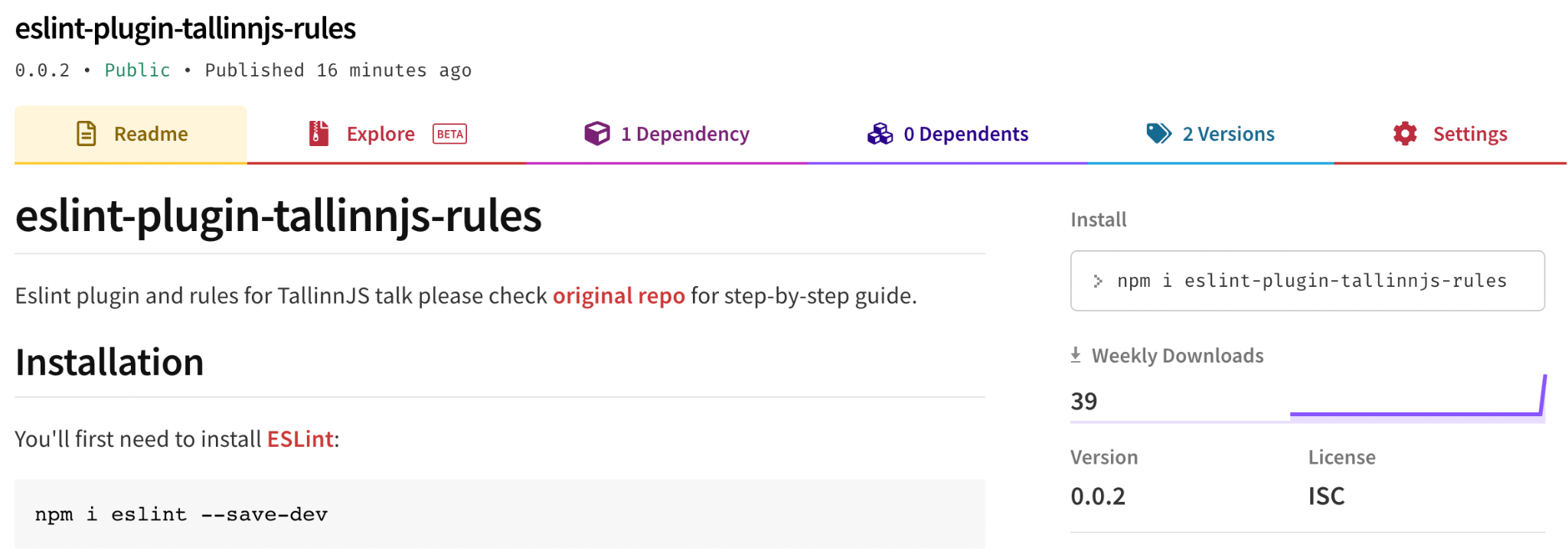


Slide 65
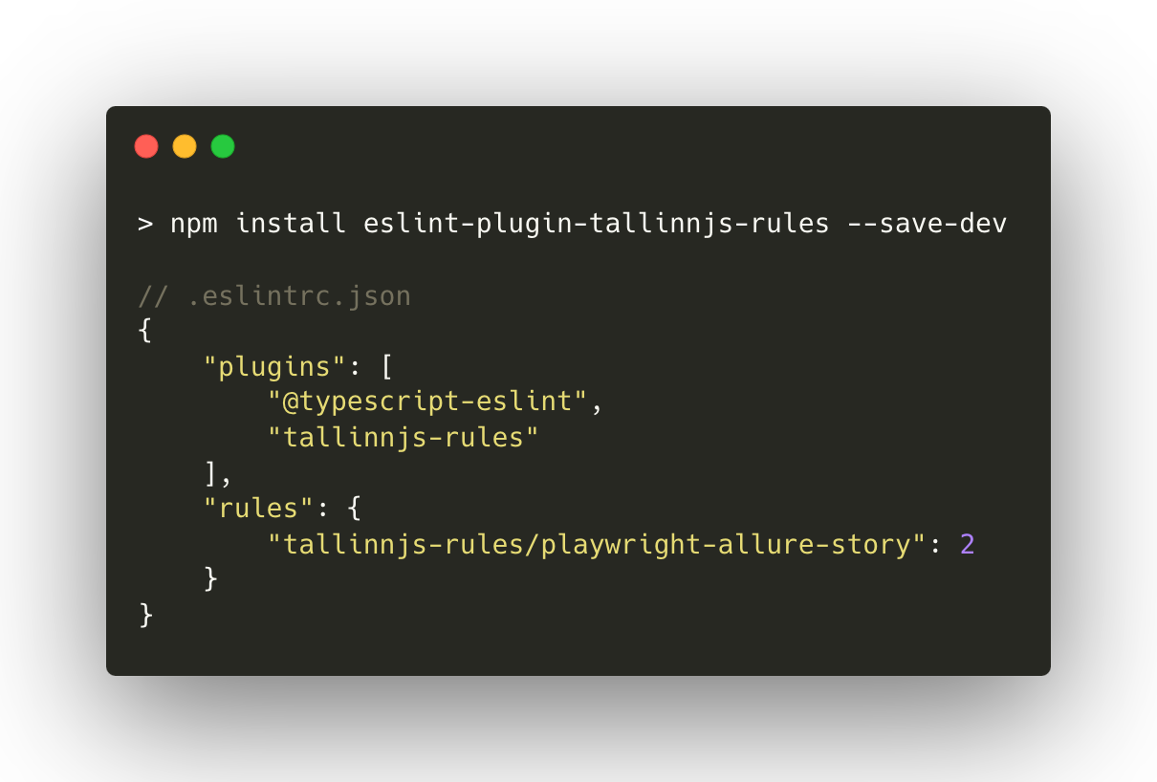

Slide 66
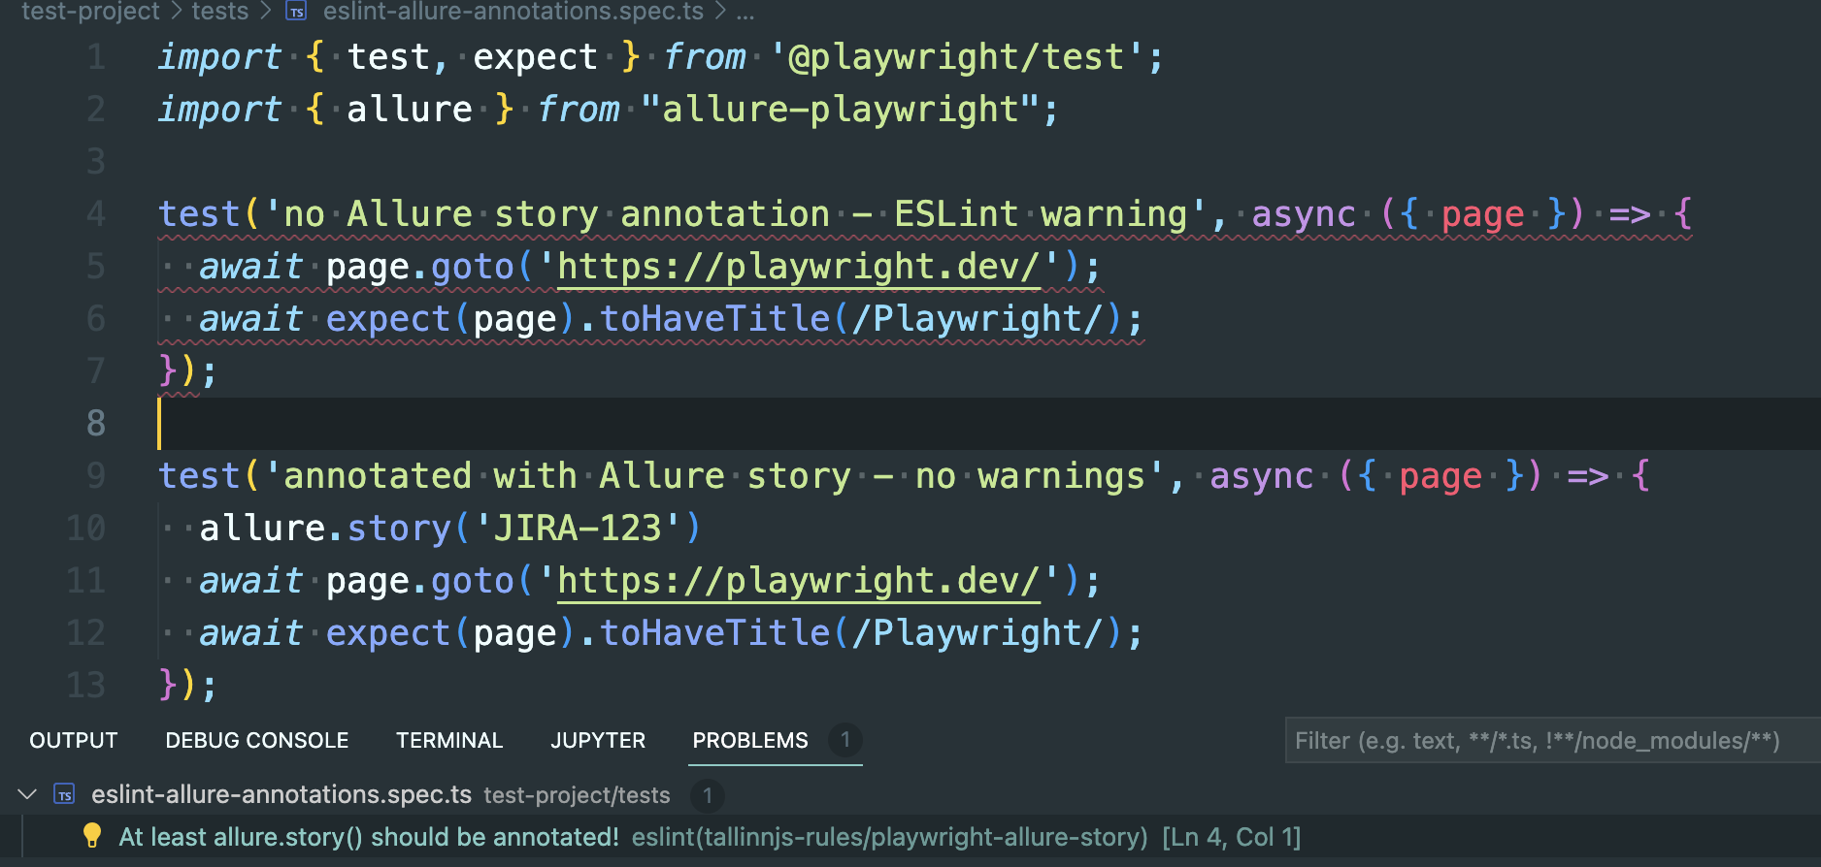
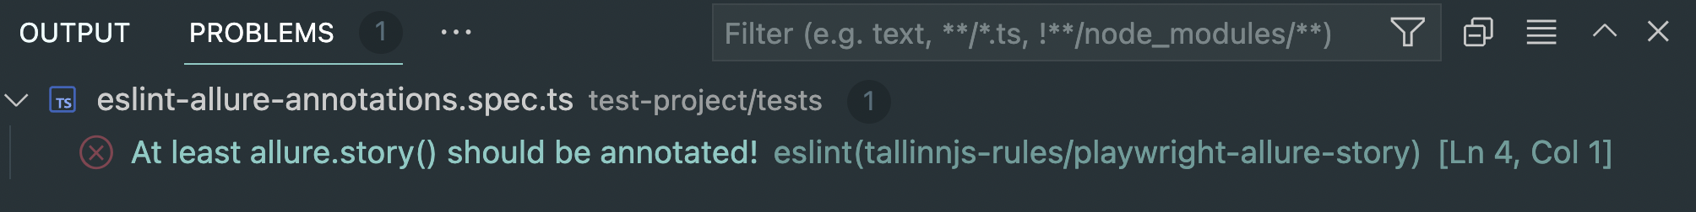

Slide 67


Slide 68
The results
Not annotated tests - visible
Both QE and Devs contributing to test annotations
Less routine tasks for QE = more testing and automation
Additionally:
Fixers can be easily added
Rule can even block PR for CI/CD
Easy to add Cypress support
or other rules

Slide 69


Thank you for your time and attention!
Questions? ention!
Veriff Code-Style
ESLint config and plugins
Prettier config
Stylelint config
Supports: JS/TS, React, Jest + (React) Testing Library

Slide 70
Step-by-step workshop repo and
references can be here:

